Slide 1
Gender Identity and the law
Cathy brennan
Radical Feminism by the Sea

Slide 2
Why This Presentation?
Discussion of the conundrum in law between “sex” and “gender identity”
Proposed solutions
Creating solidarity with constituencies to advance rights for women and girls in civil rights law

Slide 3
Guiding principles
Women and girls matter
Irrational discrimination is wrong
People have a right to live their lives as they choose without harming others
Transgender people have a right to exist and be happy
Try not to be an asshole

Slide 4
Title VII – A Primer
1. Sex discrimination involves treating someone (an applicant or employee) unfavorably because of that person's sex.
2. Discrimination against an individual because of gender identity, including transgender status, or because of sexual orientation is discrimination because of sex in violation of Title VII.
3. The law forbids discrimination when it comes to any aspect of employment, including hiring, firing, pay, job assignments, promotions, layoff, training, fringe benefits, and any other term or condition of employment.
4. It is unlawful to harass a person because of that person's sex. Harassment can include "sexual harassment" or unwelcome sexual advances, requests for sexual favors, and other verbal or physical harassment of a sexual nature. Harassment does not have to be of a sexual nature, however, and can include offensive remarks about a person's sex. For example, it is illegal to harass a woman by making offensive comments about women in general.

Slide 5
Title vii
An employment policy or practice that applies to everyone, regardless of sex, can be illegal if it has a negative impact on the employment of people of a certain sex and is not job-related or necessary to the operation of the business.
Such policy can be explicit (no women allowed to operate a piece of equipment) or neutral (no employees allowed to operate a piece of equipment if they cannot bench press 200 pounds).
Such policy can be challenged under disparate impact or disparate treatment theory (we will not discuss this today).

Slide 6
Title vii & Price waterhouse
Prior to Price Waterhouse v. Hopkins, courts did not recognize sex discrimination to include discrimination based on sex stereotypes.
In price Waterhouse, The Supreme Court recognized that employment discrimination based on sex stereotypes (e.g., assumptions and/or expectations about how persons of a certain sex should dress, behave, etc.) is unlawful sex discrimination under Title VII. Price Waterhouse had denied Ann Hopkins a promotion in part because other partners at the firm felt that she did not act as woman should act. She was told, among other things, that she needed to "walk more femininely, talk more femininely, [and] dress more femininely" in order to secure a partnership. Id. at 230-31, 235. The Court found that this constituted evidence of sex discrimination as "[i]n the . . . context of sex stereotyping, an employer who acts on the basis of a belief that a woman cannot be aggressive, or that she must not be, has acted on the basis of gender." Id. at 250. The Court further explained that Title VII's "because of sex" provision strikes at the "entire spectrum of disparate treatment of men and women resulting from sex stereotypes." Id.
The equality act seeks to codify the sex stereotypes concept in two ways – by explicitly defining “sex” to include “a sex stereotype” and by adding a definition of gender identity that is premised on sex stereotypes.

Slide 7

Ann Hopkins is a hero

Slide 8
Title vii & sexual orientation
Courts have in the past rejected lawsuits attempting to use title vii’s ban on sex discrimination by gay and lesbian people who were adversely affected in the workplace due to their sexual orientation (this is why we need the Equality act).
Recently there is a split in the federal circuit courts of appeal on this issue.
In Zarda v. Altitude Express, an employee sued his employer alleging sex discrimination in violation of Title VII. The employee, a gay man, claimed his employer fired him solely because he had disclosed his sexual orientation to a client. The U.S. District Court for the Eastern District of New York granted summary judgment to the employer, concluding the employee had failed to show he had been discriminated against because of his sex. The Second Circuit reversed, holding sexual orientation discrimination claims actionable under Title VII as a subset of sex discrimination.
The equality act Tries to remedy this inconsistency by defining “sex” to include sexual orientation. The bill defines sexual orientation as homosexuality, heterosexuality or bisexuality. It does not include pedophilia, despite the claims of Lifesitenews.com, a website regularly shared by stupid people on the internet.

Slide 9
Title VII & Gender identity
There is very good case law under Title Vii recognizing “gender identity” as an aspect of sex that is worthy of protection, thanks to the Price Waterhouse case.
None of the cases are u.s. supreme court cases, so the Equality Act also seeks to codify thIS line of cases.
The Equality Act defines “Gender Identity” as “the gender-related identity, appearance, mannerisms, or other gender-related characteristics of an individual, regardless of the individual’s designated sex at birth.”
We should all agree the definition of gender identity is only understandable so long as one understands how sex stereotypes work.
We should also agree that discrimination based on gender identity is generally wrong in most contexts.

Slide 10
The Equality Act
The Equality Act covers a number of federal laws, including:
  Employment
  Housing
  Credit
  Education
  Public Accommodations
  Federally-funded programs
  Jury service

Slide 11
The Equality Act
Hopefully, we can agree that no one should be denied credit, housing , employment or access to actually public accommodations because they are transgender. Right?
If you don’t agree with that, you might be a bigot, sorry.
If you don’t think someone can be on a jury because they are transgender, you are … beyond my care.
Moving on….

Slide 12
The Equality Act: Where the Rubber Meets the Road
The problem with the Equality Act is where the rights of Women conflict with the rights of transwomen/men. That occurs in a few ways in The Equality Act and it is important to discuss them.
the key areas we as radical feminists should be concerned about? Areas where women are vulnerable due to circumstances from which they cannot escape:
  prisons
  Homeless shelters
  Targeted direct services for Women (e.g., support services for Women in prostitution or exited Women)
  Transitional housing for Women, including exited Women
  Temporary emergency shelters
  Domestic violence shelters
  Conditions of employment requiring contact with males (prison guard ordered to search a transwoman prisoner, for example)

Slide 13
Public Accommodations
As a general rule, no one should be discriminated against in public accommodations, right? Public accommodations like a store, a coffee shop, a mall.
However, the Equality Act amends these truly public accommodations to include “establishments that provide health care” and “salons.”
Query whether this would require a health care facility that provides services exclusively to women to allow males. Think rape crisis shelters that provide therapy.
Query whether the addition of salon would require a women to wax the balls of a transwoman. Think Jonathan Yaniv.
Ask your representative to strike these specific amendments.

Slide 14
Prohibition against discrimination or segregation required by any law, statute, ordinance, regulation, rule or order of a State or State agency
This section provides currently that “All persons shall be entitled to be free, at any establishment or place, from discrimination or segregation of any kind on the ground of race, color, religion, or national origin, if such discrimination or segregation is or purports to be required by any law, statute, ordinance, regulation, rule, or order of a State or any agency or political subdivision thereof.” this provisions was enacted in response to Jim Crow laws.
Amending this is ahistorical and offensive, as there is no comparable systemic discrimination based on gender identity or sexual orientation in our nation’s history.
Amending this to insert “gender identity” is…. Problematic, as there are good reasons why women need our own space at certain times.
Lobby your representatives to strip this amendment from the Equality Act.

Slide 15
Desegregation of public Facilities
This would allow the Attorney general to prong a lawsuit to enforce “desegregation” of “Public facilities.”
Public facilities are facilities owned, operated or managed by state or local governments, like courthouses or jails.
Amending this to insert “gender identity” is…. Problematic, as there are good reasons why women need our own space at certain times. There is certainly good reason why female inmates need to be away from male inmates.
Lobby your representatives to strip this amendment from the Equality Act.

Slide 16
Desegregation of Public Education
“Desegregation” means the assignment of students to public schools and within such schools without regard to their race, color, religion, sex or national origin, but “desegregation” shall not mean the assignment of students to public schools in order to overcome racial imbalance.
Query how it makes any kind of sense to amend this provision to cover gender identity or sexual orientation but this provision is theoretically less problematic thaN others, as people should not be denied access to education based on either characteristic.
Obviously, implementation matters. How does a school handle transgender students using bathrooms, locker rooms, participating in girls’ sports? All valid questions that are answered later in this presentation…. (Spoiler Alert: it’s not a good answer).

Slide 17
Federal Funding
No person in the United States shall, on the ground of race, color, or national origin, be excluded from participation in, be denied the benefits of, or be subjected to discrimination under any program or activity receiving Federal financial assistance.
This is quite a land grab. In some instances, this is probably ok, in others, it is not.
Without a narrowing amendment, Lobby your representatives to strip this amendment from the Equality Act.

Slide 18
Programs receiving Federal Financial Assistance Where Sex v. Gender Identity Matters
Admissions criteria, schools
Athlete eligibility, schools
hospitals
Contract awards
Financial aid or scholarships, schools, students, or teachers
Health insurance and medical care
Interscholastic activity, schools, students, or teachers
Prisons
Recreational facilities
Facilities, Schools

Slide 19
Employment
The Equality act will continue to allow discrimination based on sex for “bona fide occupational qualifications” so long as “sex” includes “gender identity.”
This is a problem, but probably not for a transgender person’s co-workers. For example, me as a consumer of services can discriminate and decline service from a transgender woman employed as a security guard. I can say “don’t search me, ma’am.”
Certain “Terms & conditions of employment” Will be impacted by amendments to Title VII (We will get to that in a minute).

Slide 20

You can say “No thanks” to this Person

Slide 21
This is the big problem
For titles II (public accommodations), III (public facilities), IV (desegregation of public education), VI (federal financial assistance), VII (employment), and IX (education).
The Equality Act provides that “with respect to gender identity, an individual shall not be denied access to a shared facility, including a restroom, a locker room, and a dressing room, that is in accordance with the individual’s gender identity.’’
This is a land grab that should be pushed back on very specifically. Lobby your representatives to strip this amendment from the Equality Act.

Slide 22
Why Do We need gender Identity if Sex Stereotypes is Included
Answer… We don’t. It would be better if transgender people litigated their discrimination cases under “sex” discrimination, as they certainly are acting in a manner inconsistent with sex stereotypes.
HOWEVER, that train has left the station in the law. “Gender identity” is explicitly recognized as its own category in 21 states plus D.C.
So….. Limit the harm. Some organizations have decided to “limit the harm” by partnering with organizations that hate gay people. That’s creating additional harm.
We do not recommend that.

Slide 23
Variations on “Gender Identity”
Limit the definition to those who seek medical treatment (as suggested in the 2011 Letter to the united Nations)
Add duration, belief tests or consistency requirements a la Maryland and other states (e.g., which may be demonstrated by (1) consistent and uniform assertion of the person’s gender identity or (2) any other evidence that the gender is sincerely held as part of the person’s core identity.).
Make Gender Identity its own stand-alone definition, not included as part of “sex.”

Slide 24
Protect Sex-Specific Space
Offer an amendment to protect private space a la Maryland:
The law banning discrimination based on gender identity DOES NOT APPLY TO A PRIVATE FACILITY, IF THE PLACE OF PUBLIC ACCOMMODATION IN WHICH THE PRIVATE FACILITY IS LOCATED MAKES AVAILABLE, FOR THE USE OF PERSONS WHOSE GENDER IDENTITY IS DIFFERENT FROM THEIR ASSIGNED SEX AT BIRTH, AN EQUIVALENT PRIVATE SPACE. “PRIVATE FACILITY” MEANS A FACILITY: 1. THAT IS DESIGNED TO ACCOMMODATE ONLY A PARTICULAR SEX; 2. THAT IS DESIGNED TO BE USED SIMULTANEOUSLY BY MORE THAN ONE USER OF THE SAME SEX; AND 3. IN WHICH IT IS CUSTOMARY TO DISROBE IN VIEW OF OTHER USERS OF THE FACILITY. “EQUIVALENT PRIVATE SPACE” MEANS A SPACE THAT IS FUNCTIONALLY EQUIVALENT TO THE SPACE MADE AVAILABLE TO USERS OF A PRIVATE FACILITY.

Slide 25
Why Aligning with Right Wingers is a Bad Idea
Aligning with right wing people who oppose both sexual orientation and gender identity protections is a mistake for radical feminists because.
Our interests are not aligned.
You weaken the message of a liberation feminism by aligning with those who seek to curtail our liberation.
No one wants to listen to you because you are yelling about pedophiles and other inflammatory tropes.

Slide 26
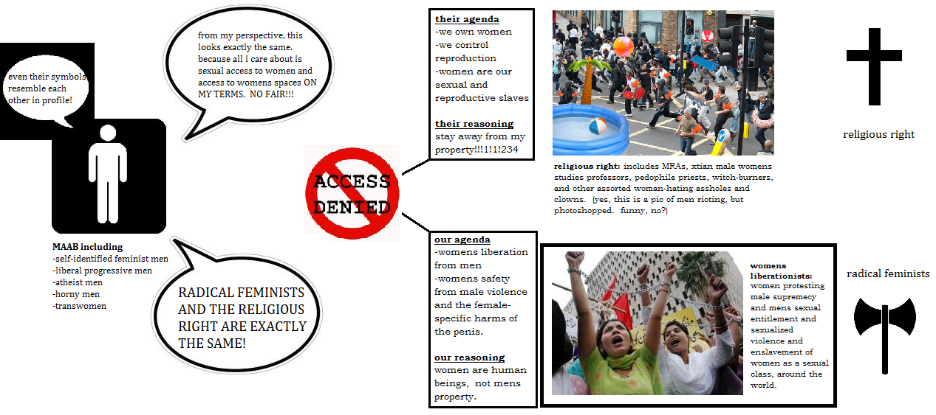

Slide 27
Questions?
Follow us
Facebook https://www.facebook.com/RadicalFeminismByTheSea/
Twitter https://twitter.com/sea_feminism
Instagram https://www.instagram.com/sea_feminism/

